Slide 1
Name: Shubham Garg
Roll No: 2010992098
Group No: 17
Instructor: Mr. Lavish Arora

Slide 2
The objective of this project is to learn and apply the concepts of HTML and CSS by creating an e-commerce website.
This website consists of the following pages:
Home Page
Feedback Page
Sign In Page
Sign Out Page
Demo Page

Slide 3
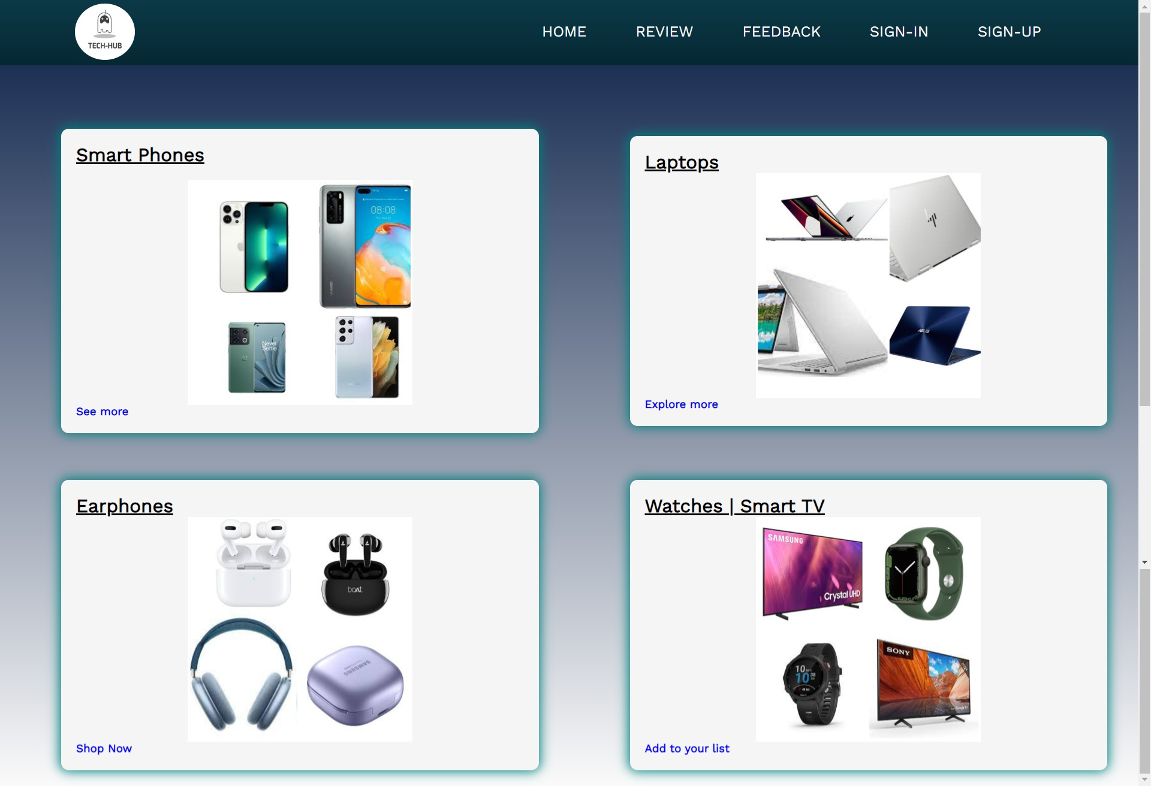
Home Page
The Home page consists of mix-sub category page like smartphones, laptops, earphones etc. available for sale on website.
It consists of navbar for easy navigation and links to open different pages.

Slide 4
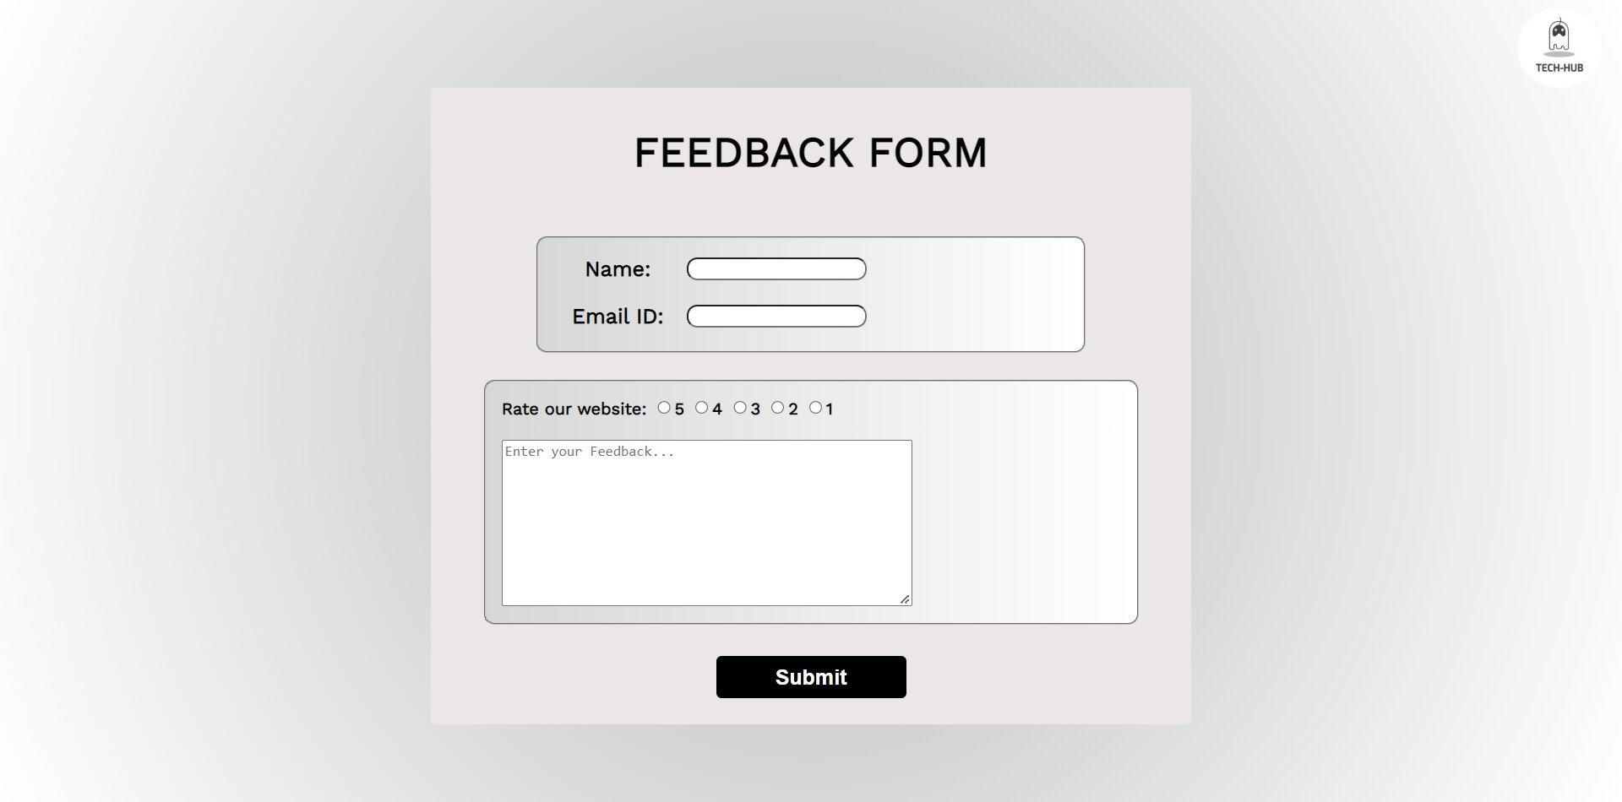
Feedback Page
The feedback page consists of various input fields such as name, email id, rating and also a text area in which user can share own experience.

Slide 5
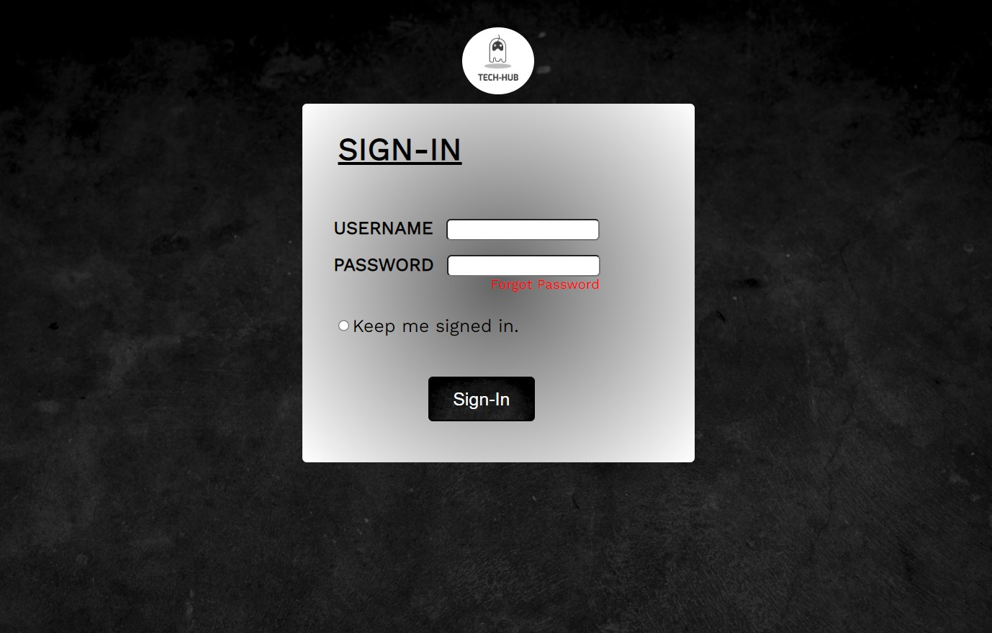
Sign-In Page
The sign in page is for the users who have already registered themselves and wish to login into the website.
It consists of input fields such as username and password.
It also provides the ability to remember the user so that next time the user can login without typing in the credentials again.

Slide 6
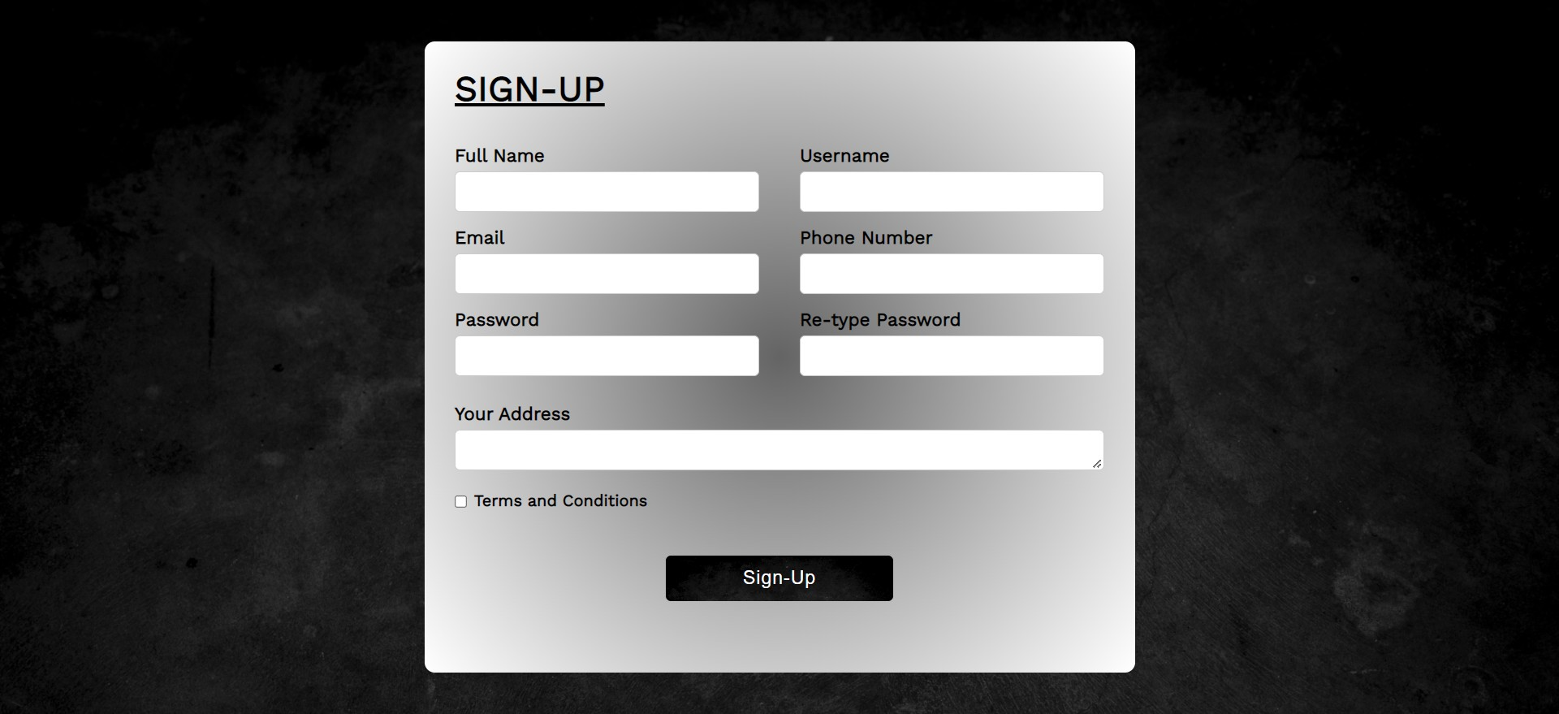
Sign-Up Page
The sign up page is used to register new users into the database.
It consists of various fields that are essential to register a new user.
It also consists of a confirm password field which enables the user to recheck the password by typing it again.

Slide 7

Reviews Page
Review page is the one in which a user can watch reviews of the product so that a person can buy without any second thought in his mind.

Slide 8
Thank You

